Slide 1
AI voice clone
Submitted by:
Gursimar Kaur (1820036)
Sandeep Kaur (1806007)

Slide 2
Introduction
The main goal of Voice Clone in AI is to build a TTS system which can generate natural speech for a variety of speakers in a data efficient manner. We specifically address a zero-shot learning setting, where a few seconds of un-transcribed reference audio from a target speaker is used to synthesize new speech in that speaker’s voice, without updating any model parameters.

Slide 3
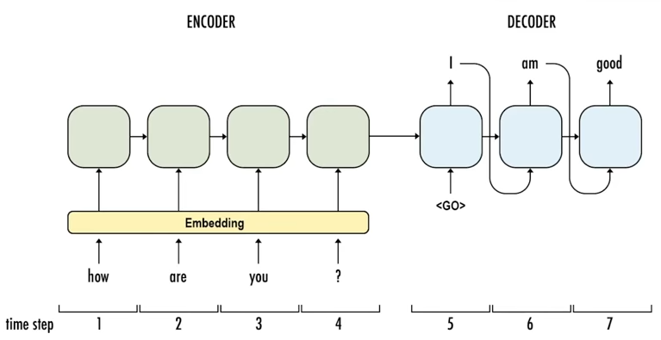
Technology used

Slide 4
Text to phonemes
Why? –“though” and “rough” should be pronounced so differently, even though they have the sane suffix. As such, we need to use a slightly different representation of words that reveal more information about the pronunciations.
White Room – [W, AY1, T, ., R, UW1, M, .] Crossroads – [K, R, AO1, S, R, OW2, D, Z, .]

Slide 5
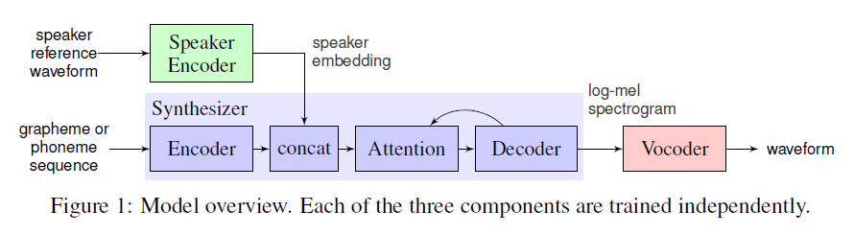
Main functioning
Three main components are:
Speaker encoder
Synthesizer
Speaker vocoder

Slide 6
algorithm
Sound will be recorded using microphone as the input of the project.
The sound will be analysed in the form of wavelength, frequency, pitch of the speaker, locations to which the person belongs, native language of the person and many more independent and dependent variables will be notified.
After this the dataset will be maintained and then training set will help the machine coding built to get trained about the data. The machine then finds correlations among the datasets.
The machine learns the voice or speech of the person with respect to the various dependent and independent variables.
Then the input taken is given to the system and that is processed according to the data given at the time of training a system.
Output is generated according to the training given to the code of the project and the dataset provided.

Slide 7
Need of the system
This system will help to build test to speech in a natural voice.
Help the users to have the recording of their voice for number amount of data without actually recording the audio file.
Provide a secured and safe voice cloned speech.
They could also enable new applications, such as transferring a voice across languages for more natural speech-to-speech translation, or generating realistic speech from text in low resource settings.
Needed for people who have accidently lost their voice. It will restore their ability to communicate naturally.

Slide 8
thanks

